Slide 1
Shoe Stock Estimation
Al bundy’s Shoe store Stock estimation using statistics in ms excel

Slide 2
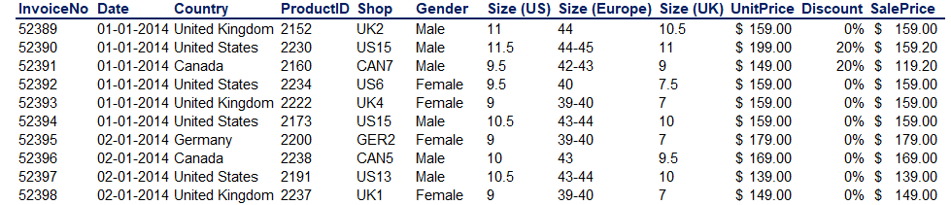
Problem Statement
Al Bundy Shoe shop has Shoe shop in different countries like United States, United Kingdom, Canada and Germany. Since, they lost many of their shoe stock and got out of stock in some of their stores of Unites States and Germany. They have asked us to analyse the previous sales data and predict the shoe stock they should keep. So, they do not face this type of problem in future.
Snapshot of Data Provided

Slide 3
Approach
Goal - Using Inferential Statistics we can calculate the confidence interval for the shoe stock.
Steps:
Apply Filter in columns for quick analysis of the data.
Get the number of shoes sold on the basis of size in United States in 2 separate table for male and female.
Create new sheet, Get the number of shoes sold on the basis of size in Germany in 2 separate table for male and female.
Applying inferential Concept to get confidence intervals for different shoe size, Round it of if get in decimals.

Slide 4
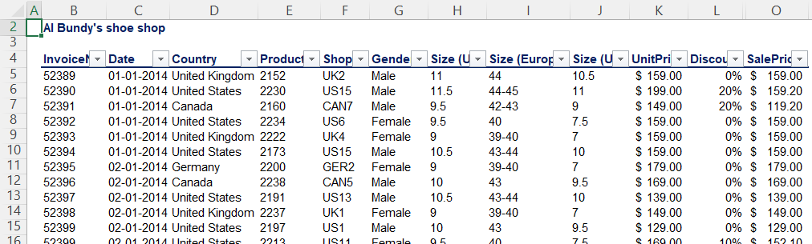
Apply filter for quick analysis of data in table
Filter
By applying filter you can check that how many distinct values does column contains. For Example, Column Country has 4 distinct country name i.e. Canada, Germany, Unites Kingdom and United States.
Any wrong value data can also be detected. This will tell if any data cleaning required or not.

Slide 5
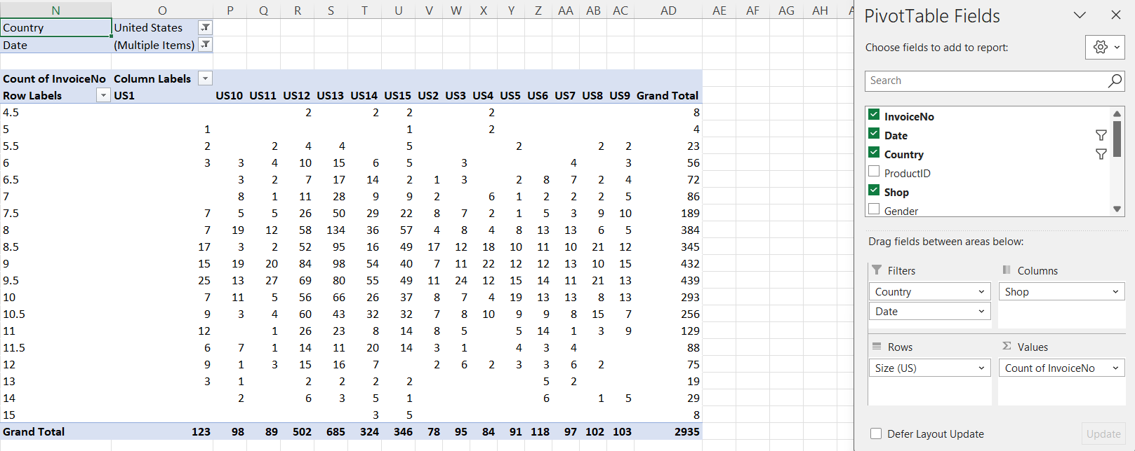
Using Pivot Table to get Required Data

Slide 6
Apply essential filter, rows, column and choose count of invoice no. in values to get count of shoe pair sell.
Since, we are considering sales of 2 years i.e. 2015 and 2016 only for United States and Germany.
Apply shoe count for men using filter.
Manipulate the pivot table accordingly.
Copy essential data from pivot table and make new table in new worksheet for better representation.
Now, the only part remaining is statistical calculation.

Slide 7


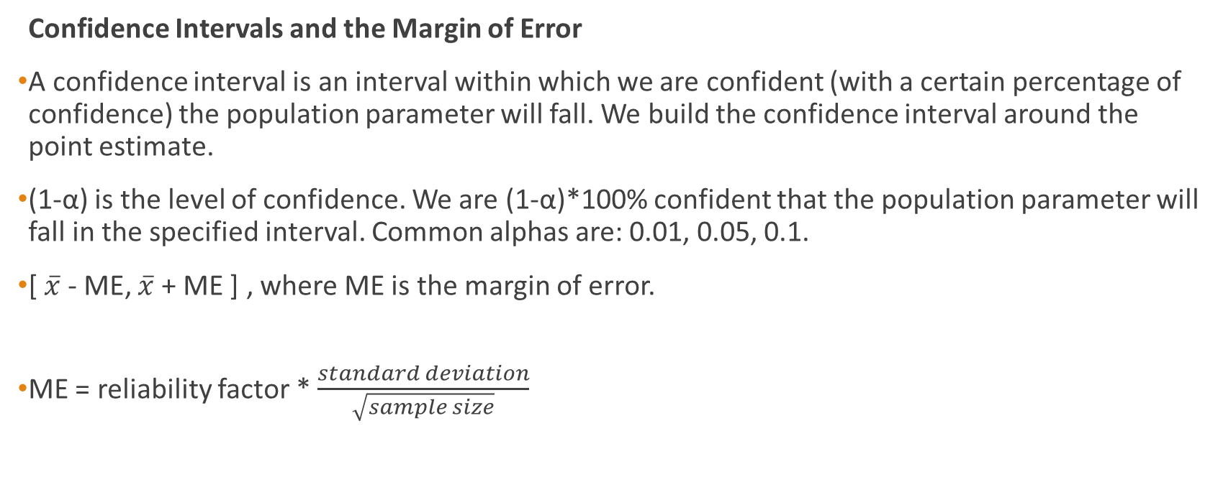
Inferential Statistics
Confidence Intervals and the Margin of Error
A confidence interval is an interval within which we are confident (with a certain percentage of confidence) the population parameter will fall. We build the confidence interval around the point estimate.
(1-α) is the level of confidence. We are (1-α)*100% confident that the population parameter will fall in the specified interval. Common alphas are: 0.01, 0.05, 0.1.
[ $\overline{x}$ - ME, $\overline{x}$ + ME ] , where ME is the margin of error.
ME = reliability factor * $\frac{standard deviation}{\sqrt{sample size}}$

Slide 8
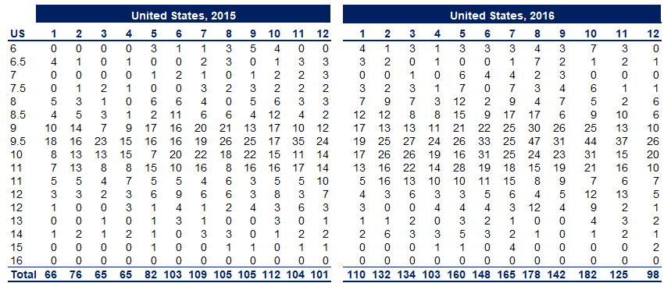
Task 1: Calculate the confidence intervals for men shoes sales in the USA, this time based on a bigger sample - 2015-2016.
Values table made using pivot table

Slide 9
Cont…
Create Mean Column: Calculate mean of shoe count for each size of both table using formula =MEAN() .
Following Condition looks like the one population with population variance unknown
Test: I am considering t-test for this condition because we don’t know population variance
considering significance level of 95% therefore alpha become 0.05
and sample size is 24 therefore degree of freedom becomes 23.
t_{95%,23} or t_{0.025,23}

Slide 10
Cont…
Create Standard Error Column: Calculate standard error using formula =STDEV.S()/SQRT().
Marginal Error Column: Get marginal error by multiplying standard error for each size to got t_{95%,23} using t table.
Confidence Interval Column: Subtracting marginal error with mean give lower value of confidence interval and Adding marginal error with mean give higher value of confidence interval.
Round Up Column: Round up the higher value of confidence interval using formula =ROUNDUP()

Slide 11
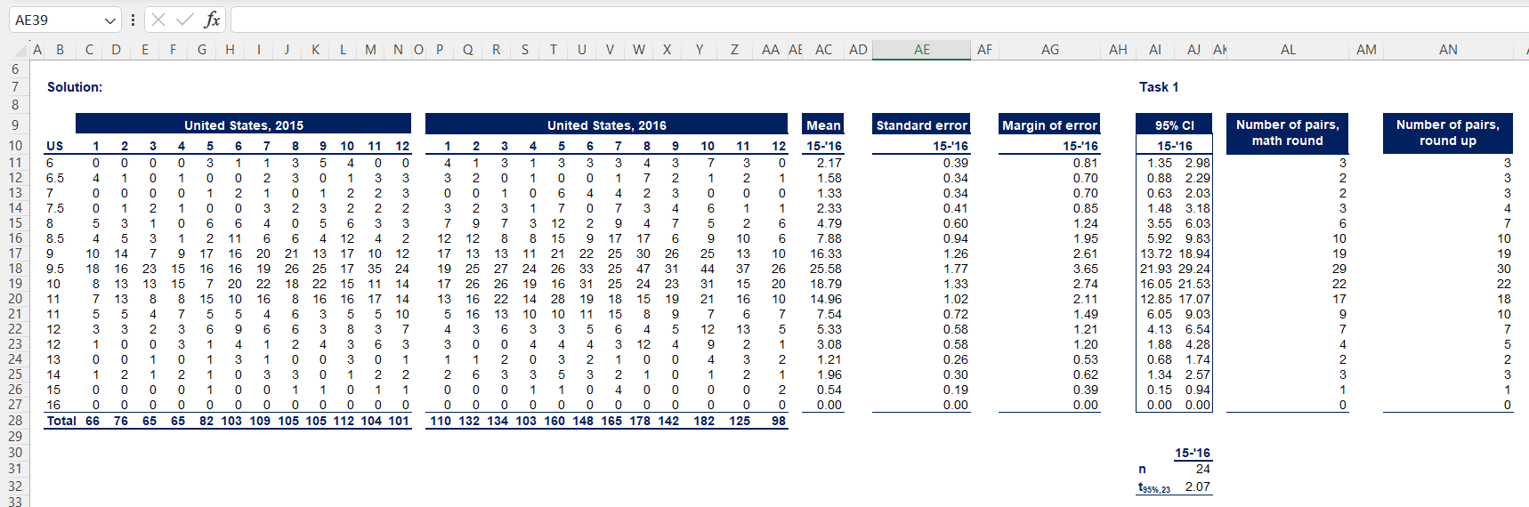

Slide 12
Task 2: Compare the results with the confidence intervals when the sample was based just on 2016.
Follow the same procedure as task 1 but this time the slight change in value as follows:
We will use 2016 table to calculate mean
Our sample size becomes 12.
This will effect value of standard error (standard error/sqrt(sample size)).
Therefore degree of freedom becomes 11.
Observation in difference of task 1 and 2:
The numbers are close, however most shoe sizes seem overestimated when we base the prediction only on one year. This may be because 2016 was a very good year for sales, while 2015 wasn't.

Slide 13
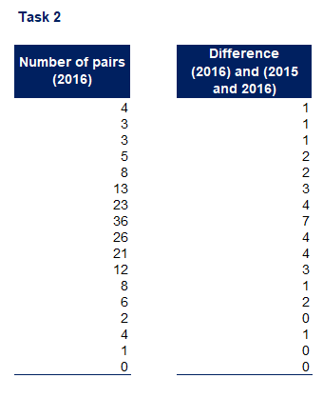

Slide 14
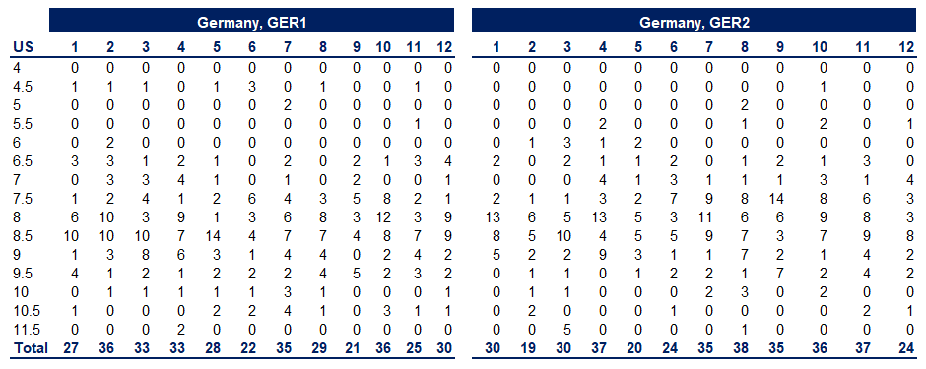
Task 3: Estimate the 90% confidence interval for the same but this time for women shoes. What changes can you see?
This time taking women shoe count on the basis of size of 2 different stores of Germany.
Values table made using pivot table

Slide 15
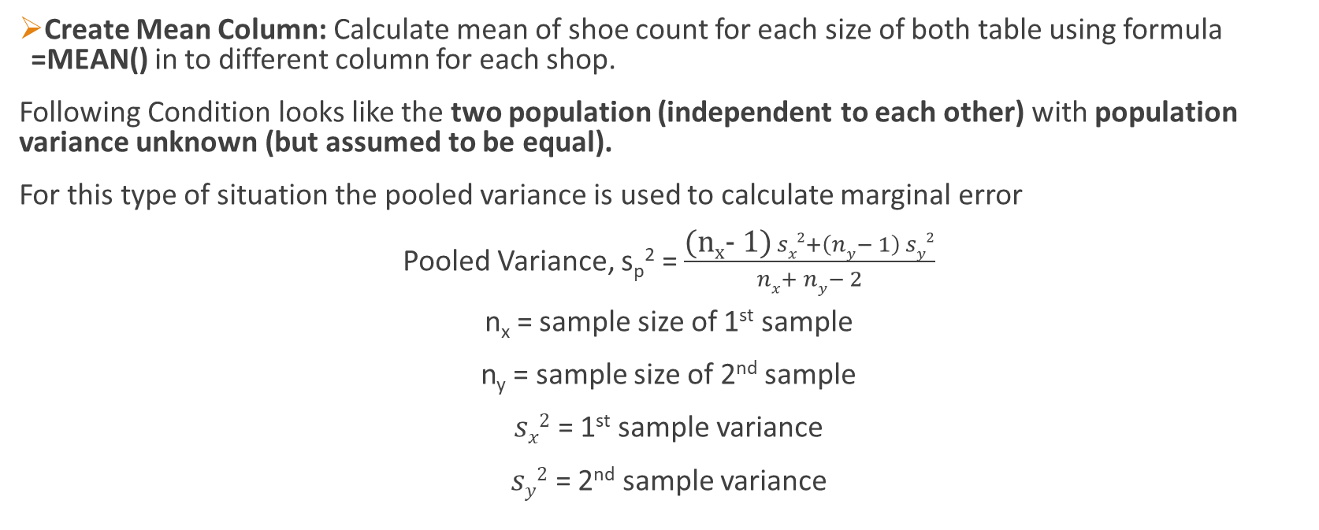
Cont…
Create Mean Column: Calculate mean of shoe count for each size of both table using formula =MEAN() in to different column for each shop.
Following Condition looks like the two population (independent to each other) with population variance unknown (but assumed to be equal).
For this type of situation the pooled variance is used to calculate marginal error
Pooled Variance, s_{p}² = $\frac{\text{(}\text{nx}\text{- }\text{1}\text{)} sx2+\left(ny− 1\right) sy2}{nx+ ny− 2}$
n_{x} = sample size of 1st sample
n_{y} = sample size of 2nd sample
$sx2$ = 1st sample variance
$sy2$ = 2nd sample variance

Slide 16

Cont…
Marginal Error, ME =
Confidence Interval, CI =
Test: I am considering t-test for this condition because we don’t know population variance considering significance level of 90% therefore alpha become 0.1 but this time we need to take pooled variance and sample size is 11 therefore degree of freedom becomes 20.
Sample Variance: Get sample variance for each shoe size for each shop in different column using formula =VAR.S().

Slide 17
Cont…
Pooled Variance: Select column in excel cell according to the formula of pooled variance.
Marginal Error: Select column in excel cell according to the formula of pooled variance.
Confidence Interval, CI: Subtracting marginal error from the difference of means of both the population will give lower value of confidence interval whereas adding marginal error from the difference of means of both the population will give higher value of confidence interval.
Observation:
For three shoe sizes (marked), we can see that one shop outperforms the other. For three shoe sizes (marked), we can see that one shop outperforms the other. This shows you that the level of confidence does make a difference. Notice that the intervals are narrower.

Slide 18
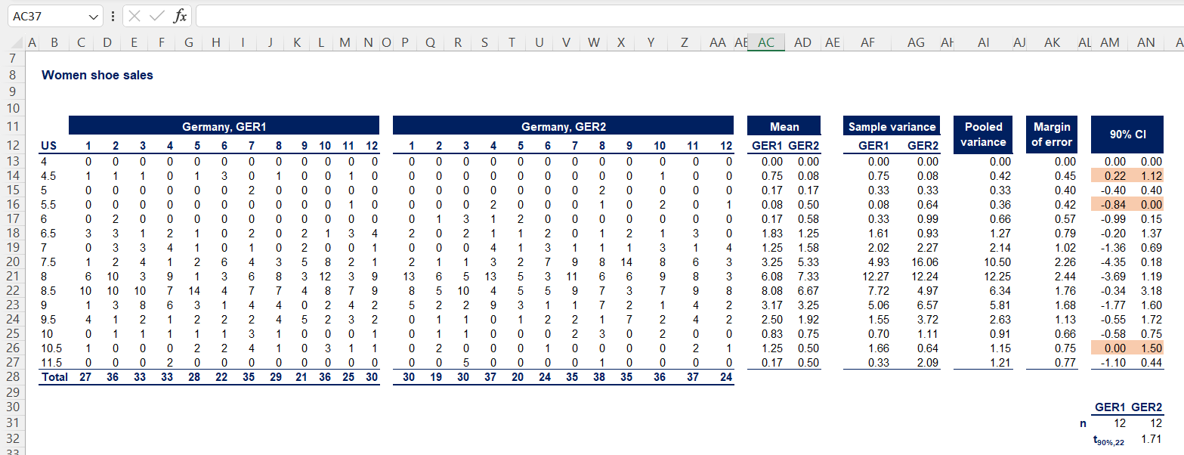

Slide 19
Thank You
Project By:
Chaman Patel
21121017

